Slide 1
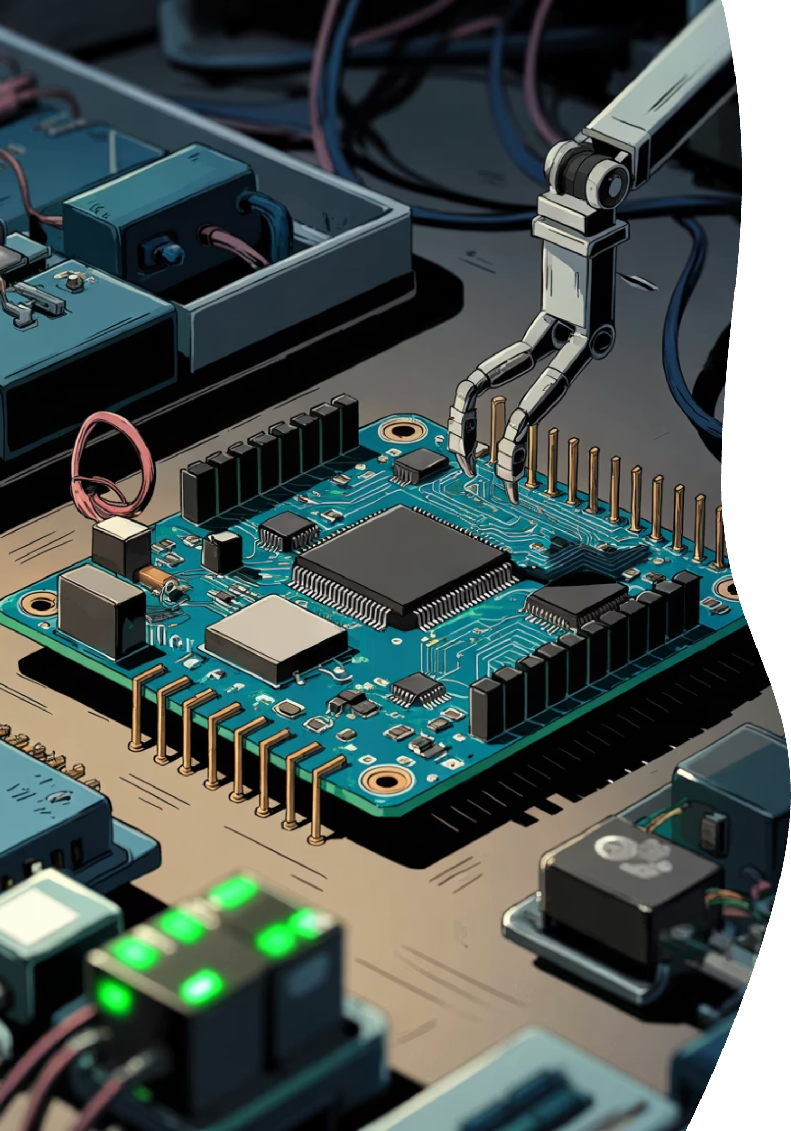

Multi-Sensor Monitoring System
Faculty of Engineering — Power Electronics, First Year Electrical Department
Prepared By:
Farouq Walid Farouq Mohamed
Omar Osama Mohamed Nassef
Ammar Mohamed Abdallah ·
Waheed Ibrahim Ali
Supervised By:
Dr. Ahmed Eid

Slide 2


Project Overview
The Multi-Sensor Monitoring System is an embedded systems project designed to monitor environmental conditions in real time using sensors connected to an Arduino UNO R3.
Detect Fire
Measure Distance
Monitor Water Level
Bluetooth Data
Trigger Alarms
Main Objective: Improve safety and automation in homes, laboratories, and industrial environments.

Slide 3

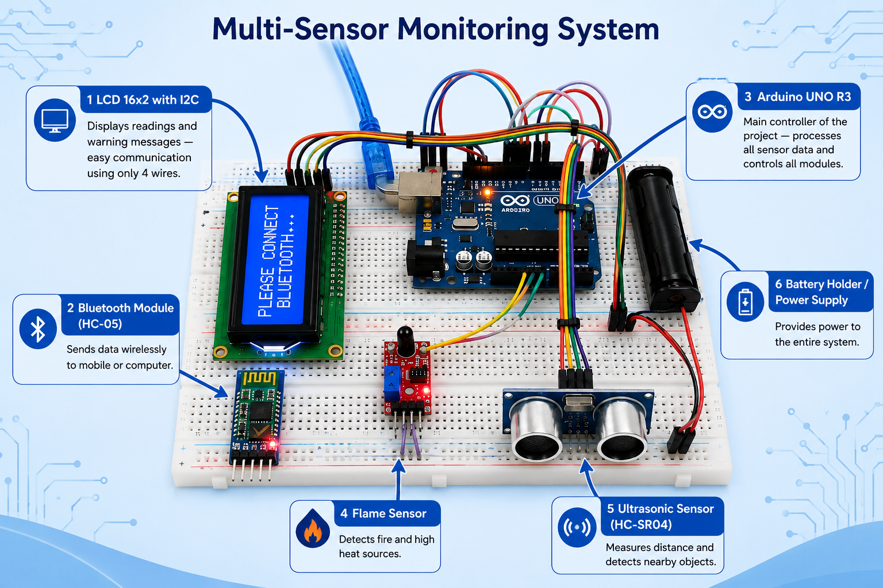
Arduino & LCD
LCD 16x2 with I2C
The LCD screen displays system readings and warning messages in real time.
Arduino UNO R3
Arduino is the main controller of the system and acts as the brain of the project.
Functions:
Receives sensor data
Processes information
Controls alarms and output devices
The Arduino works using a USB cable or external battery and is programmed using Arduino IDE.
🔥 Fire Detected
💧 Low Water Level
📶 Bluetooth Connected

Slide 4

Bluetooth Communication
Bluetooth Module (HC-05)
The Bluetooth module allows wireless communication between the Arduino circuit and a mobile phone. The project uses the Bluetooth Electronics application for monitoring the system.
How It Works:
Turn on Bluetooth on the phone
Open Bluetooth Electronics app
Connect to HC-05 module
View live sensor data
Wireless Monitoring
Real-Time Data Display
Easy Communication
Stay connected to the system from anywhere nearby.
Instant updates from sensors and live system readings.
Simple pairing and fast setup for everyday use.

Slide 5
Sensors
Modern sensor modules for fire detection, distance measurement, and water monitoring in IoT systems.
Flame Sensor
Ultrasonic Sensor
Water Sensor
Detects fire quickly and triggers alerts when flames are present.
Measures distance accurately using ultrasonic waves.
Monitors water levels and sends warning signals when needed.

Slide 6
System Operation
How the System Works
Step 3
Step 2
Results appear on the LCD screen
Step 1
Arduino processes the sensor readings
Sensors collect environmental data
Step 5
Step 4
The buzzer and LEDs activate during danger situations
Data is sent wirelessly through Bluetooth

Slide 7
Applications of the System
Real-World Applications
Key Advantages
Smart safety systems
Fire alarm systems
Real-Time Monitoring
Low Cost
Water tank monitoring
Wireless Communication
Easy to Expand
Smart irrigation systems
Fire-fighting robots
Industrial and kitchen safety

Slide 8

Conclusion
The Multi-Sensor Monitoring System demonstrates how Arduino and sensors can work together to create a smart and efficient safety system.
The project improves monitoring, automation, and protection in many real-world applications.

